Slide 1
Project 3: behavior of school metrics and crime rates in Philadelphia
Presented by:
Elizabeth Vandergrift
Juan Camilo Bohorquez Rozo
Eric Croston

Slide 2
The Data
PhilaSD.org
SPREE 2023 School Performance
OpenDataPhilly.org
2024 Crime Incidents
Police Station Locations
School Locations
Zip Code Boundaries
PSA Boundaries

Slide 3
School Metrics
School Report on Education and Equity (SPREE)
Example Metrics: Attendance, Graduation Rates and PSSA/Keystone Results
294 School IDs and 323 Total Schools
260 Metrics per School
4 Report/School Types: High School, Middle School, K-8 Schools and Elementary Schools
84 High Schools
29 Middle Schools
154 K-8 Schools
56 Elementary Schools

Slide 4
School Metrics
Data Cleaning and Prep for Database Import
Create a dataframe for each report/school type
Create lists of metrics to keep for analysis
Reduce the number of rows per school
Pivot the dataframes to turn the duplicate school rows into columns
Rename the pivoted columns
Change the data types for analysis
Export CSV file to import into our database

Slide 5
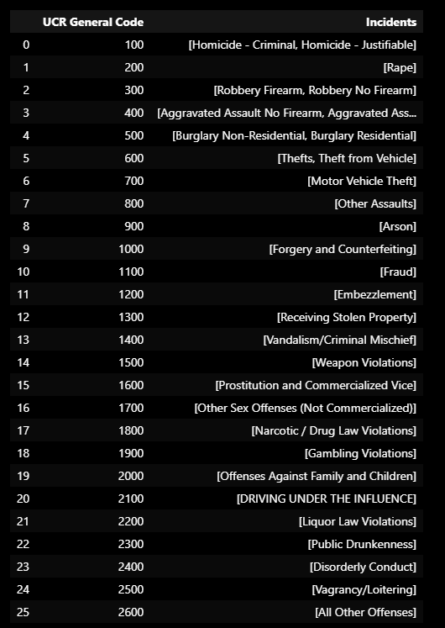
Crime incidents
There were 85,529 Crime Incidents Documented by the Philadelphia Police Department From January 1st, 2024 until July 17th, 2024.
For Each Crime there is a Numerical Code and Incident Description.
There are 26 different unique incident types with specific codes.

Slide 6
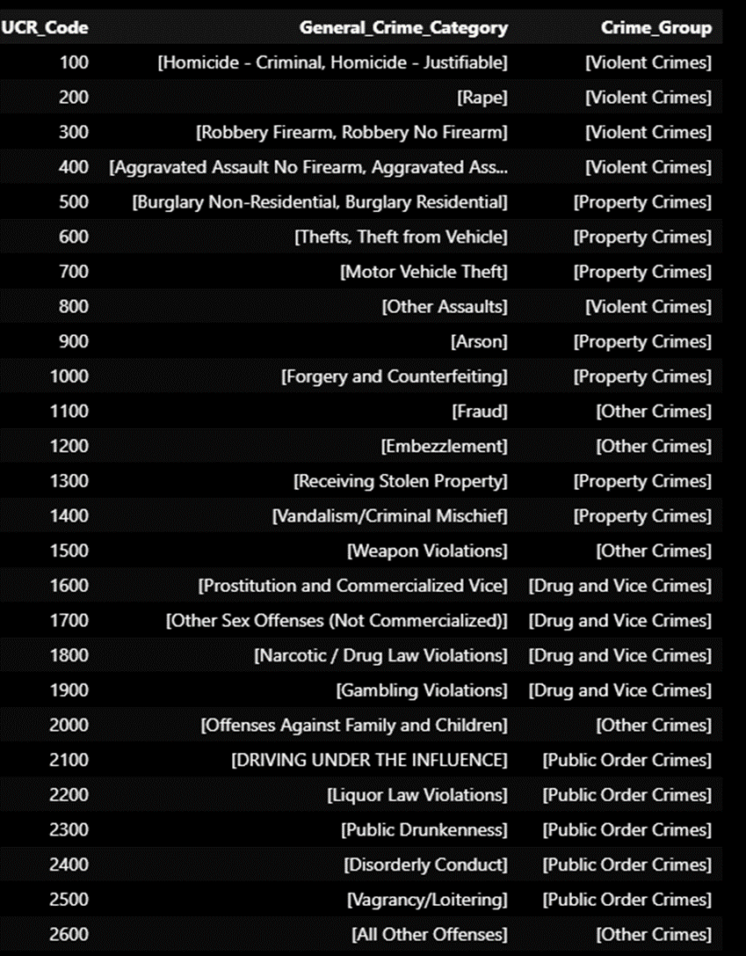
Crime incidents
Crime Incident Types were grouped into related crime categories to be able to make comparisons.
'Violent Crimes': ['Homicide - Criminal', 'Homicide - Justifiable', 'Rape', 'Robbery No Firearm', 'Robbery Firearm', 'Aggravated Assault Firearm', 'Aggravated Assault No Firearm', 'Other Assaults’],
'Property Crimes': ['Burglary Residential', 'Burglary Non-Residential', 'Thefts', 'Theft from Vehicle’, ‘Motor Vehicle Theft', 'Arson’, ‘Forgery and Counterfeiting', 'Receiving Stolen Property', 'Vandalism/Criminal Mischief’],
Public Order Crimes': ['Disorderly Conduct', 'Vagrancy/Loitering', 'Public Drunkenness', 'Liquor Law Violations', 'DRIVING UNDER THE INFLUENCE’],
'Drug and Vice Crimes': ['Prostitution and Commercialized Vice', 'Narcotic / Drug Law Violations', 'Other Sex Offenses (Not Commercialized)', 'Gambling Violations’],
'Other Crimes': ['Offenses Against Family and Children', 'Fraud', 'Embezzlement', 'Weapon Violations', 'All Other Offenses’

Slide 7
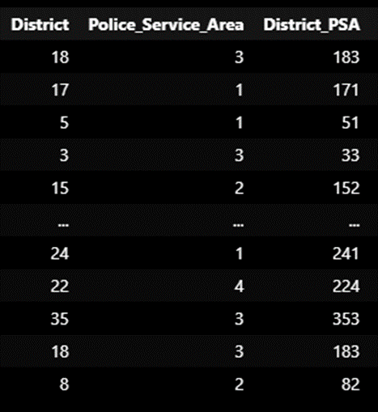

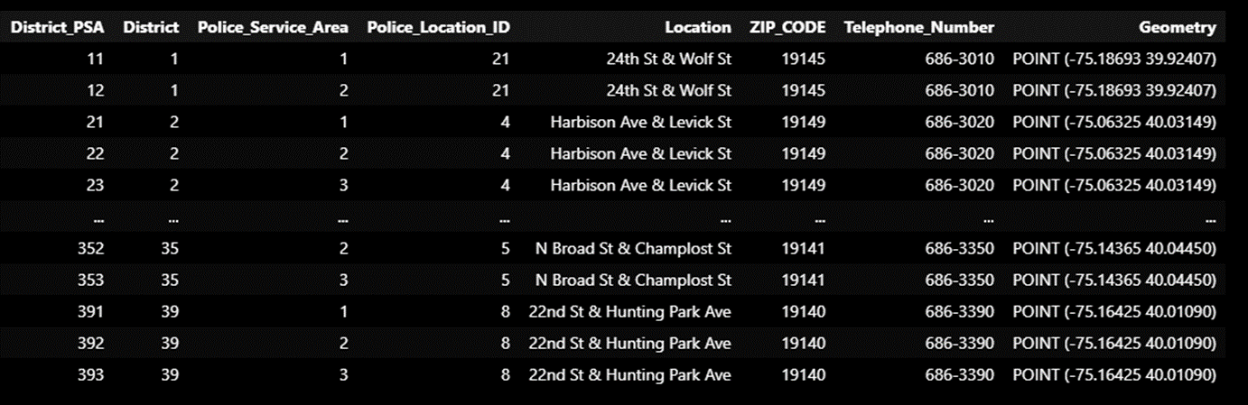
Creating a composite key for District PSA including the District and the Police Service Area number within that District
District PSA composite added to Police Station Location and Police Incident locations

Slide 8
How are We Going to Connect over 85K Incident locations with Schools and Their Metrics????
Our plan was to use ZIP Codes….

Slide 9
But that did not work….
Only some files had ZIP Codes, and the largest file with Police Incidents (85K rows) did not!
We also found looping through 85K rows of data to determine if a school point is within the same polygon Zip Code of a crime was not easily possible.
Possibly, we could find the common ZIP Codes by using the Police Station Coordinates and School Coordinates in the ZIP Code?
However, this does not account for Crimes handled by the Police District in Different ZIP Codes. ZIP Codes and Police Districts- Police Service Area are not aligned.
Then we found another plan….

Slide 10
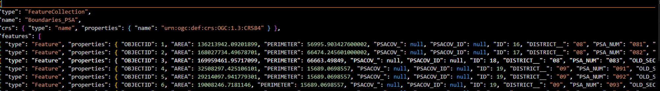
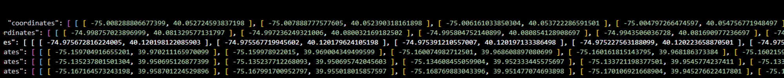
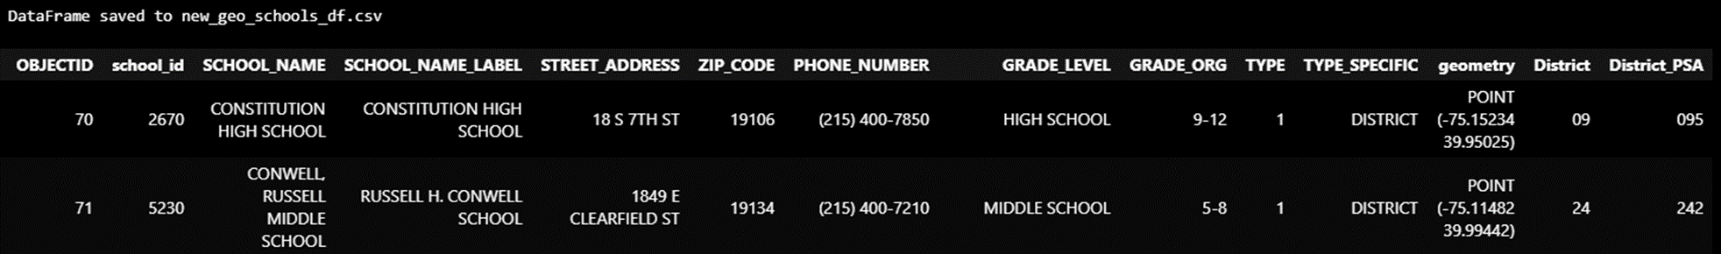
Police Service Area boundaries GeoJson File and School Coordinates

Slide 11
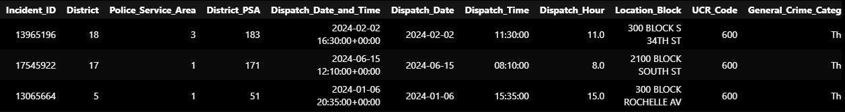



Connecting School Locations and Police Service Areas Incident Locations Using a Combination Key and Points within the Service Area Polygon
Using Two smaller datasets to be able to connect the larger data sets

Slide 12
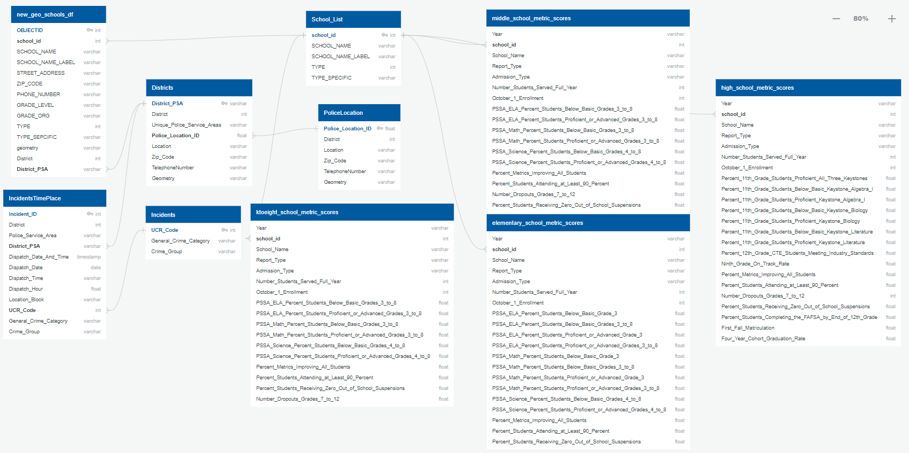




Entity Relationship Diagram (ERD)

Slide 13
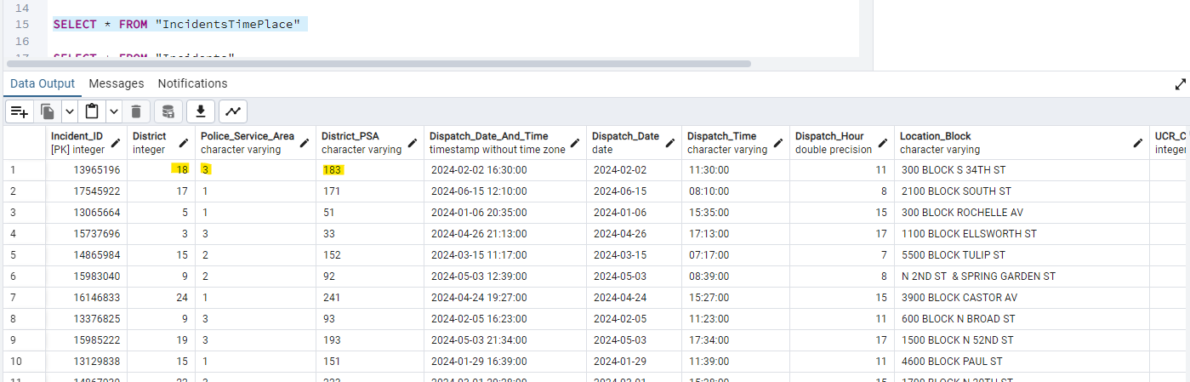
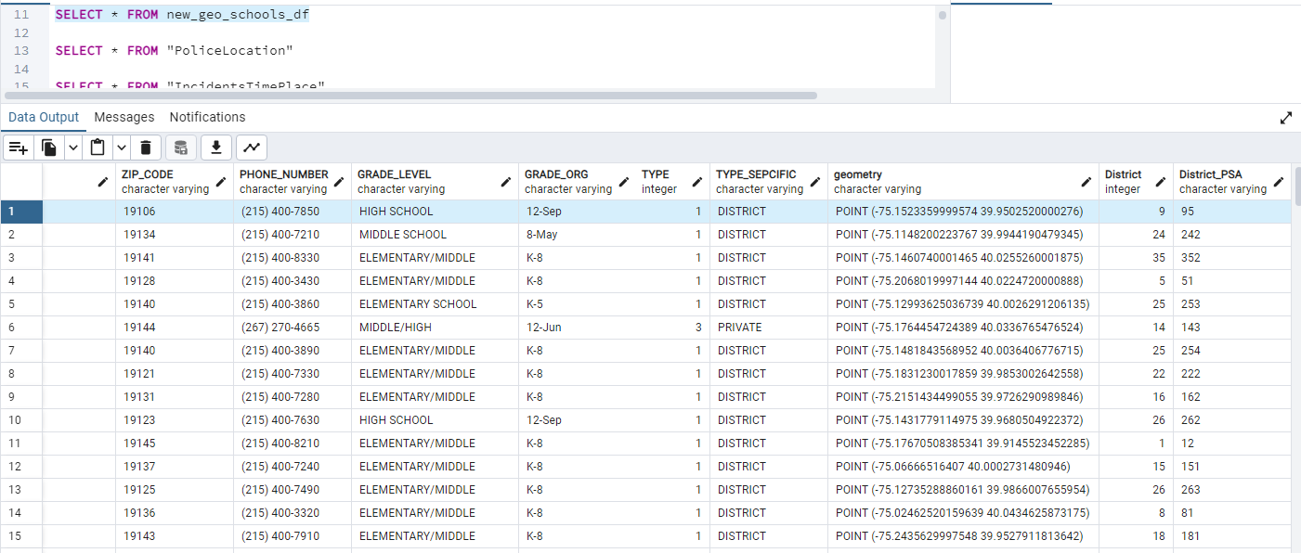


Crime incidents Locations And School Locations

Slide 14
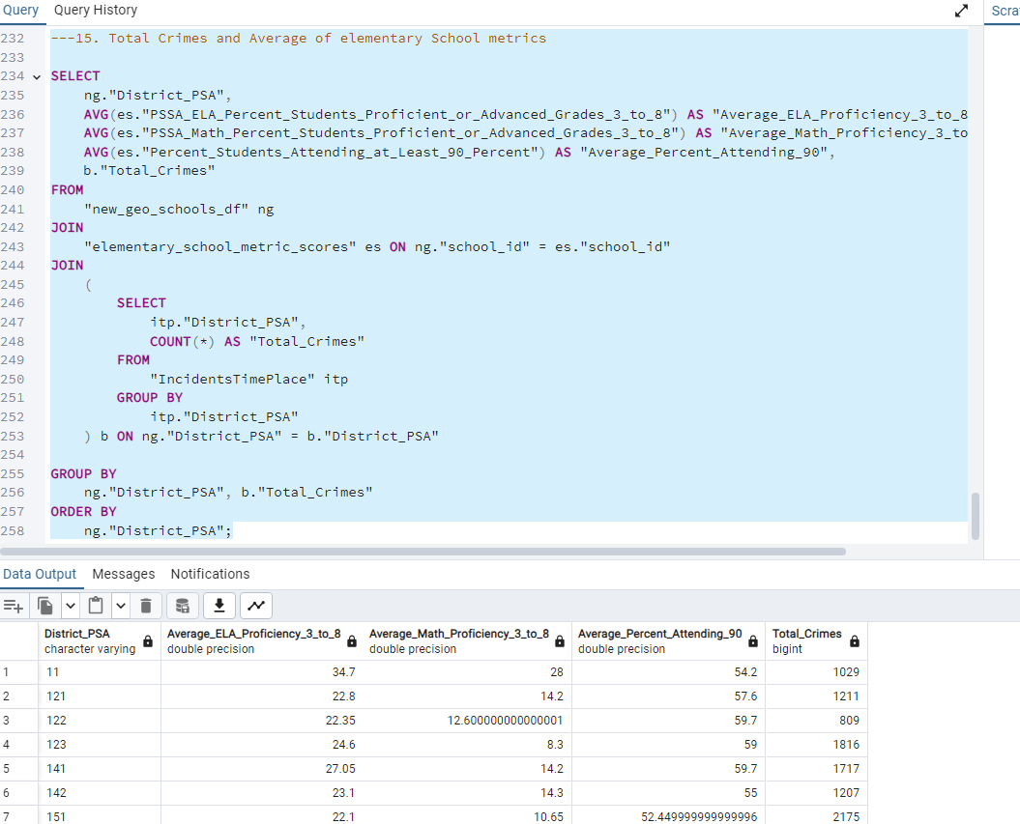





Crime incidents And School Metrics

Slide 15
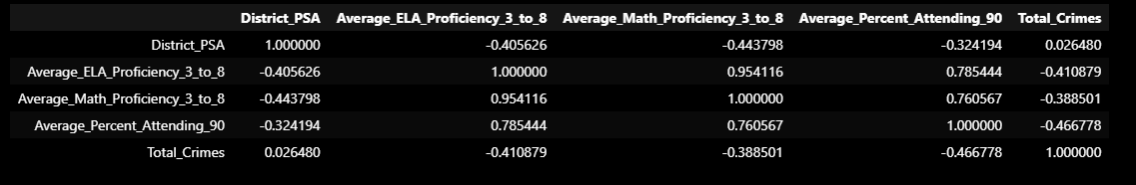
Analysis
When this Crime Incidents and School Metrics for Elementary Schools was exported from SQL and added as a Panda’s DataFrame, it was found that there was a correlation between Crime and Schools Metrics.

Slide 16
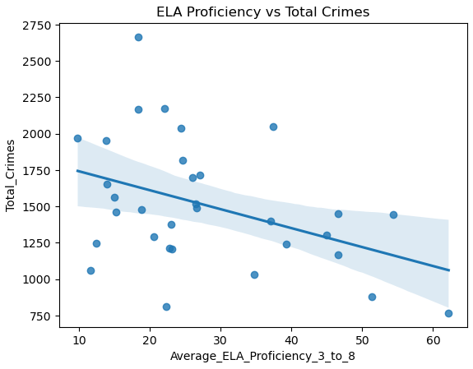
Analysis- With PandaS Dataframe
and Now we will analyze with Java Script Visualizations

Slide 17
Thank you
Elizabeth Vandergrift
Juan Camilo Bohorquez Rozo
Eric Croston

